Slide 1
Sched’Up
The way to schedule up
Shir Lev
Tomer Filiba
Yana Tartakovsky
Ofir Ventura
Tel Aviv University
Blavatanik School of Computer Science
Google Workshop for Web Technologies, 2013-2014

Slide 2
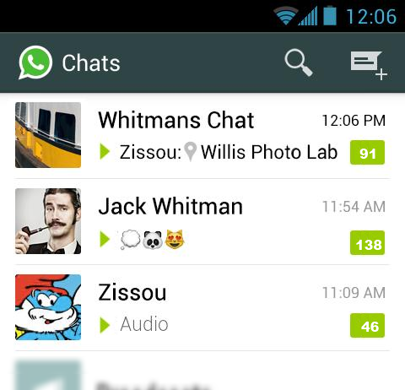
The Problem
Plan a night-out with friends?
Want to set up a study session with your classmates?
Need to find time for a meeting with colleagues?
HELP!!!!!

Slide 3
Sched’Up To The Rescue
Schedule an event within minutes
Eliminate back-and-forth messages
Create a new meeting, choose time span (visually, on a calendar) and send invites
Your participants receive a real-time notification and see relevant times sync’ed with their calendars.
They choose preferred time slots and submit
When everybody is ready, you pick the best time and send an invite

Slide 4
Main Features
Keep your calendar private
Quickly close the loop
Automatically suggest the best times
Sync with your phone’s contacts and calendar(s)
Optional Features:
Backgrounds/presets
Personal preferences (Shomer Shabat, etc)
Connect with Facebook (and create event)

Slide 5
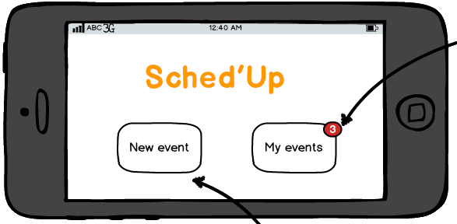
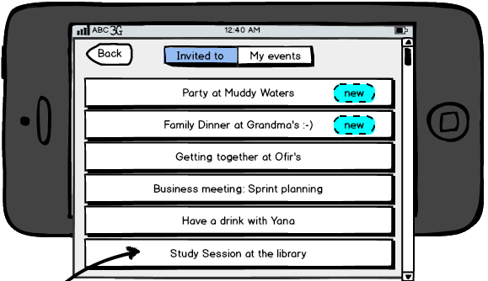
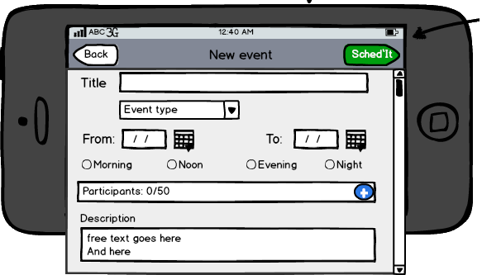
Mock-Ups

Slide 6
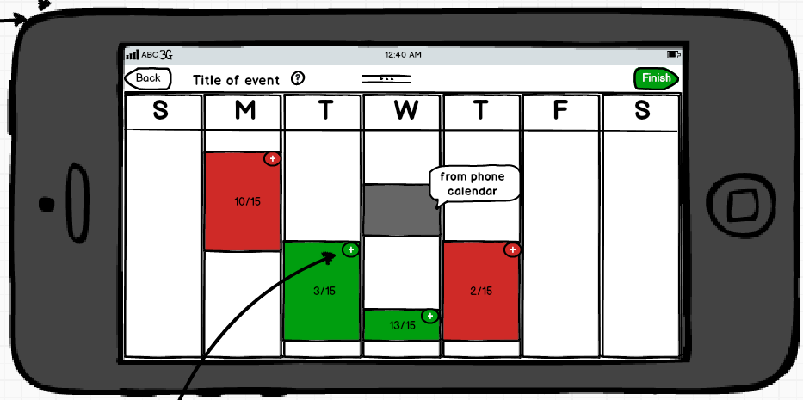
Mock-Ups

Slide 7
Milestones
Milestone #1 - MVP
Basic event creation (title, contacts, send invite)
Notify participants, accept/decline, add to calendar
Milestone #2
Visual calendar (sync with phone calendar on both sides)
Focus on UI
Milestone #3
User votes screen (set/cancel/change)
My meetings/invited to lists
Optional feature

Slide 8
Competition
Most scheduling/calendar apps help you manage your calendar and focus of looks/ease of use.
They are not “social” and don’t help you find times
Doodle is the main “competition”, but doodle is much more inclined towards polls
You create a poll with times and people vote
Guests can’t suggest times, and you’re not given an aggregated view of everyone’s availability
Moreover, it doesn’t have “event types”, time-of-day (morning/evening) or day range (“must happen this week”)

